Slide 1
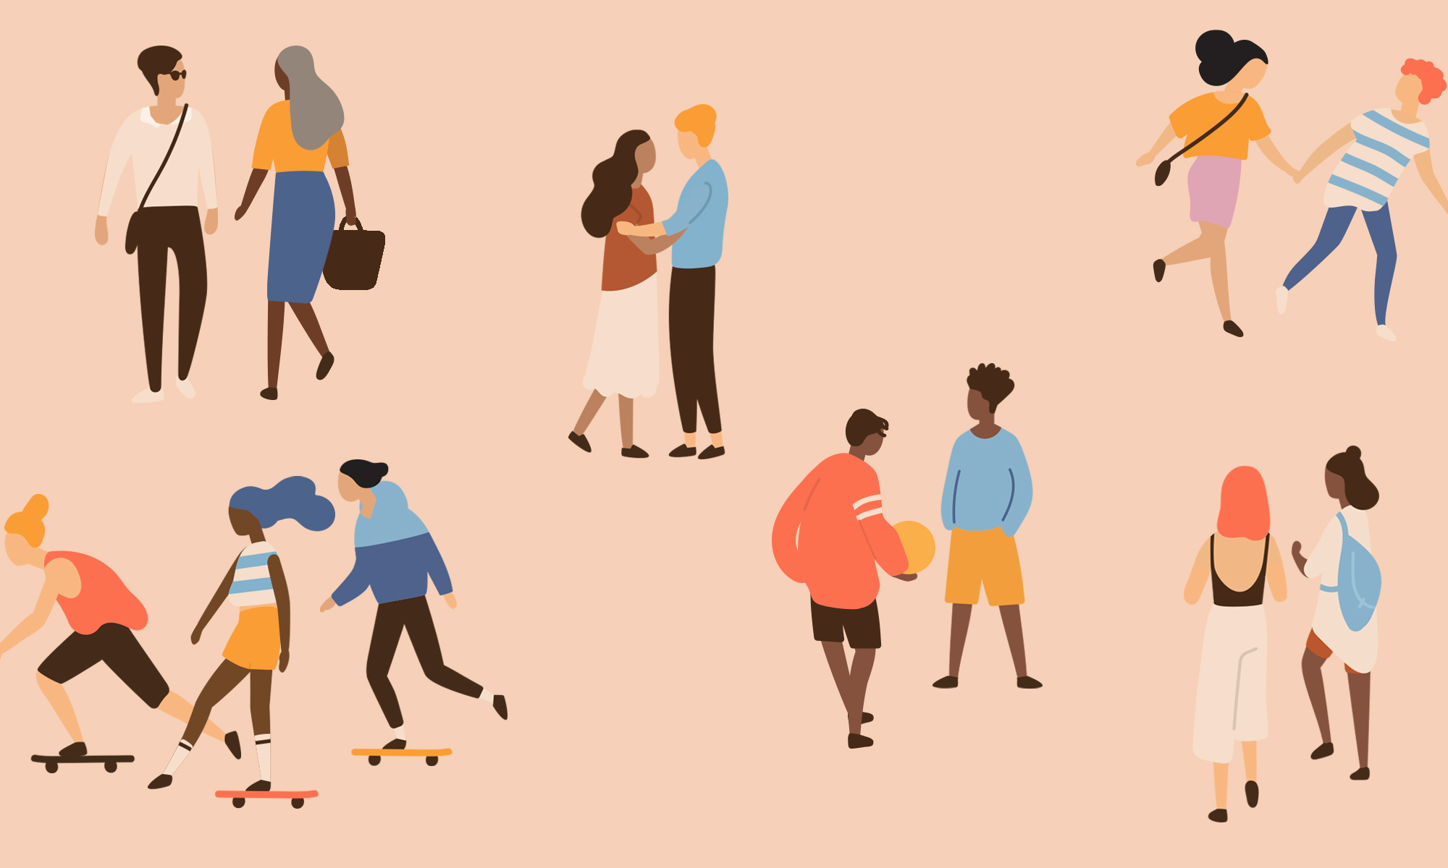
Relationships
Year 10 Health 2024
Lesson 4

Slide 2

Todays Focus:
Outline the cycle of abuse.
Find resources to access help and help someone else.
Analyse media to identify healthy, unhealthy and abusive characteristics in relationships.

Slide 3

TOPIC TEST NEXT WEEK
Notes:
Any time remaining at the end of the lesson can be spent doing revision.

Slide 4

In the following slides we will be watching and discussing topics that may be sensitive. If something upsets you, please let the teacher know.

Slide 5
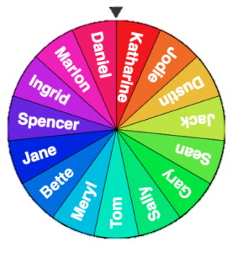
Optional Hook: What do you see? (pg.19)
Watch the following clips.
Take note of the characteristics of healthy or unhealthy relationships that you see in each one.
Be prepared to share your thoughts as names will be drawn at random.
Notes:
Students will have to go back through their book to pg.19. Activity is at the top of the page – ‘Healthy or Unhealthy – what do you see?’ (above relationship expectations).
TW: physical and emotional abuse is shown in the first video. If this is a problem for your class, you can skip this activity.
Alternative – watch the ‘Monica and Chandler’ video and identify the positives followed by a class discussion about how that situation could have been different if they shared an unhealthy relationship.

Slide 6
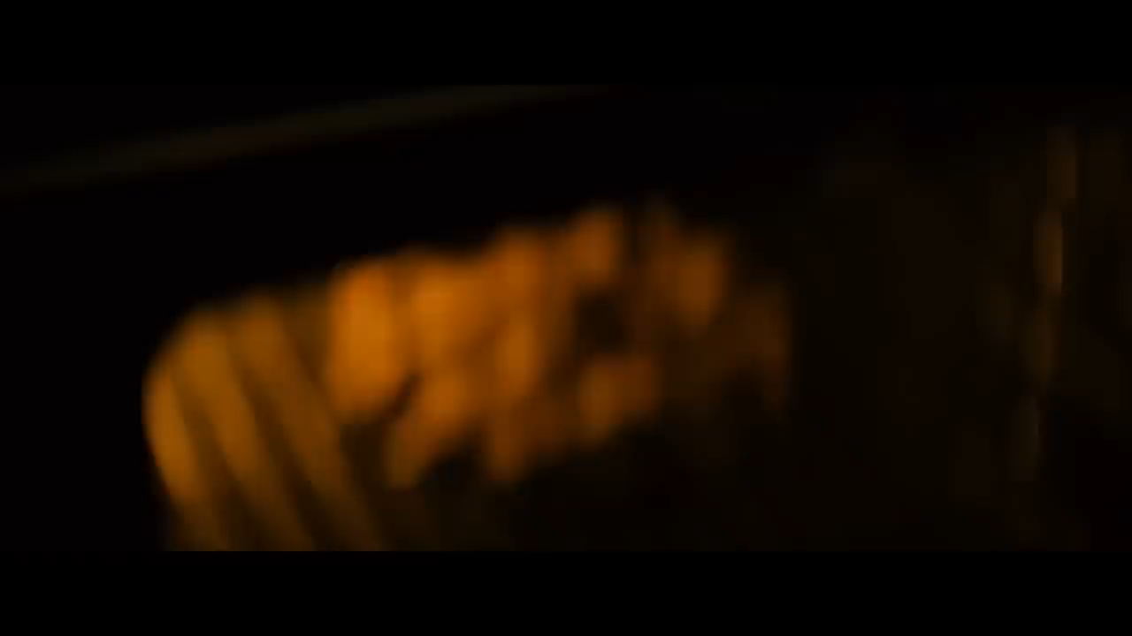
Notes:
This scene is from the movie ‘Safe Haven’ (M). It shows how she is trying to escape from her abusive ex-partner and in doing so, she has moved to another town and changed her name and her appearance. She is experiencing a flashback of how he was abusive to her.
(3:02min)
TW: physical and emotional abuse is shown in this video. If this is a problem for your class, you can skip this activity.
Alternative – watch the ‘Monica and Chandler’ video and identify the positives followed by a class discussion about how that situation could have been different if they shared an unhealthy relationship.

Slide 7
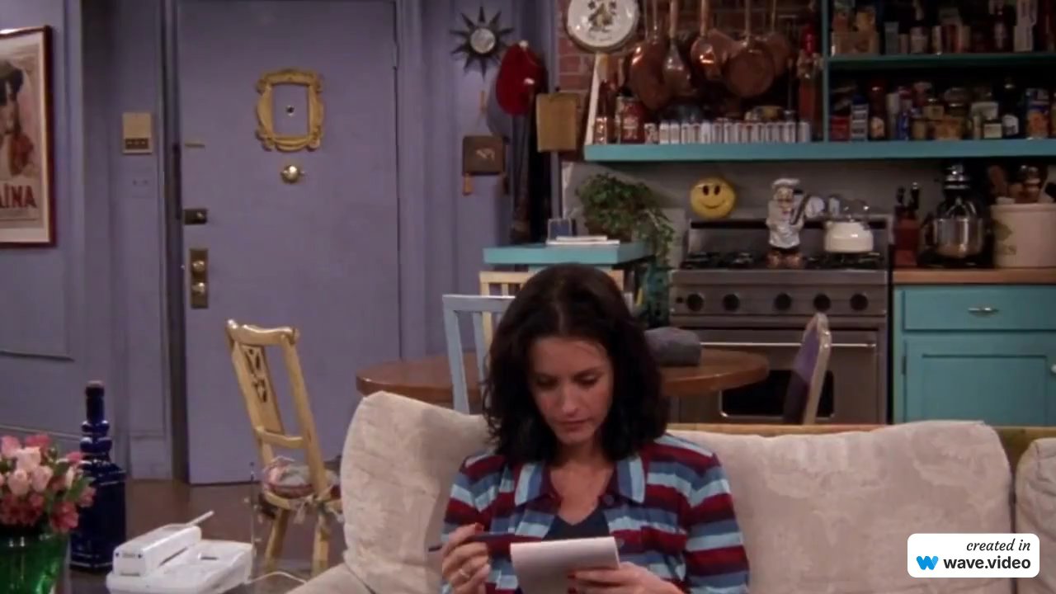
Notes:
This scene is from an episode of ‘Friends’, after Monica and Chandler have had a fight. They show signs of a healthy relationship through communication, compassion, and love.
Alternative – watch the ‘Monica and Chandler’ video and identify the positives followed by a class discussion about how that situation could have been different if they shared an unhealthy relationship.

Slide 8
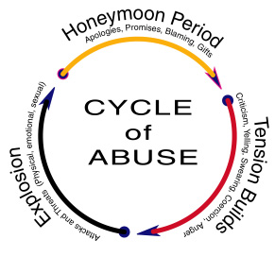
Activity 1: (pg.23)
Cycle of Abuse
The cycle of abuse represents the pattern that abuse may occur in. It is made up of 3 components:
  Honeymoon Period
  Tension Building
  Explosion
Use the following slides to fill in the missing information in your books.
Notes:
Relevant to test – students need to be able to draw it and describe it

Slide 9
Honeymoon Period
Occurs right after an instance of physical, sexual, or emotional abuse.
During this time, an abuser will apologize for their behaviour while showing sorrow and promising that the abuse will never happen again.
They may also place blame on the victim for the episode of abuse or act like the abuse never happened.
An abuser may express love through gifts and statements during the honeymoon period.
Both the abuser and the victim may believe that their relationship is now stable and safe, that all abuse is over and will never happen again.
This part of the cycle of abuse can make it more difficult for a victim to leave the relationship.

Slide 10
Tension Building
When the honeymoon period ends, tension will start to build in the relationship.
An abuser may start getting angry again and making difficult demands.
They may start breaking promises they made in the honeymoon phase and stop expressing love or affection.
The victim may start to fear for their safety and give in to the abuser’s requests.
The victim may be extremely careful about what they say or do as tension is building.

Slide 11
Explosion
Finally, the tension is too much, and the abuser commits an act of abuse.
Abuse may range from physical abuse, like hitting, to emotional abuse such as name-calling and humiliation.
The goal of abuse is always to gain power and control over the victim using any means necessary.
It’s important to remember that physical harm is not the only type of abuse. The abuse can take a variety of forms.

Slide 12

GLOSSARY: (Pg. 7)
At the front of your books is your glossary. Turn to your glossary and add the following words and their definitions:
Cycle of Abuse:
  Represents a pattern of how abuse may occur in a relationship.
  It is made up of 3 components:
    Honeymoon Period
    Tension Building
    Explosion
Notes:
Relevant to test

Slide 13

Where to get help? (pg.24)
People often stay in an abusive relationship for longer than they should. Once you know that you are in an abusive relationship, however, you should do something about it.
If you are in immediate danger, call triple zero (000). The police are there to protect you. If you need to get out, you could go to a refuge, a trusted family member or friend.

Slide 14
Where to get help?
(pg.24)
Women’s Domestic Violence Helpline 1800 007 339 or (08) 9223 1188
Men's Domestic Violence Helpline 1800 000 599 or (08) 9223 1199
1800RESPECT: National Sexual Assault, Domestic Family Violence Counselling Service: 1800 737 732. You can use their website to find services in your area.
Lifeline — 13 11 14 provides support if you are suffering a personal crisis or are thinking of suicide.
Kids Helpline — 1800 55 1800 — a confidential service for young people aged between 5 and 25 via telephone, email, and web.
MensLine Australia — 1300 78 99 78 — provides support to men having relationship problems and men who use or experience family and domestic violence.
Notes:
Discuss

Slide 15

How can you help a friend? (pg.25)
Listen to what your friend has to say. Believe them.
Be supportive, encouraging, open and honest.
Listen without judging, be supportive, encouraging, open and honest.
Ask if they need help from a support service, and/or help create a safety plan.
Help them to get advice and support (i.e., 1800 RESPECT etc.)
You access help yourself to get support on how to help someone.
Offer to go with them if they meet with a support service.
Remind your friend it is not their fault.
Continue to be a friend even when you feel frustrated by their decisions or actions.
Notes:
Relevant to test
Fill in the blanks

Slide 16

Activity 2: Media Review (pg.26-27)
Health campaigns exist to promote positive behaviours and try to discourage negative behaviours and make the consumer/viewer aware of what is considered ‘bad’ or unhealthy.
While watching the videos, answer the questions in your book about what the ad is saying and how the campaign portrays that message.
  What types of abuse are shown in the ad and provide examples.
  Describe the cultural attitudes and behaviours that are depicted.
  Outline the health impact that is shown.
  What is the overall message of the ad/campaign and how is this message portrayed?
Notes:
Relevant to test.
2 ways to do activity – choose what best suits your class and time.
Option 1: Choose one video and answer together as a class and allow students to complete the questions for the second video individually.
Option 2: Students answer the questions for both videos individually.

Slide 17
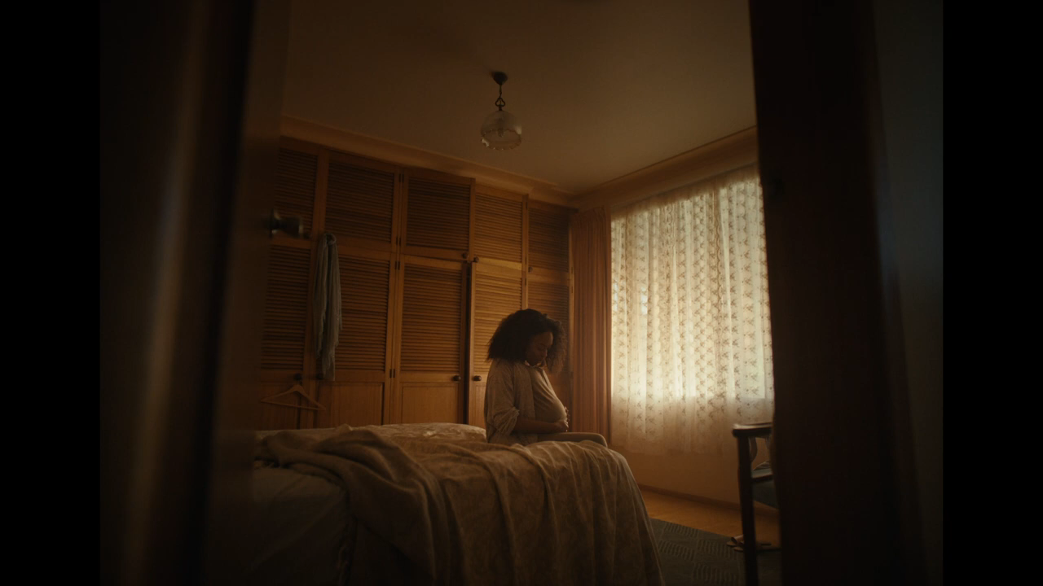

Slide 18
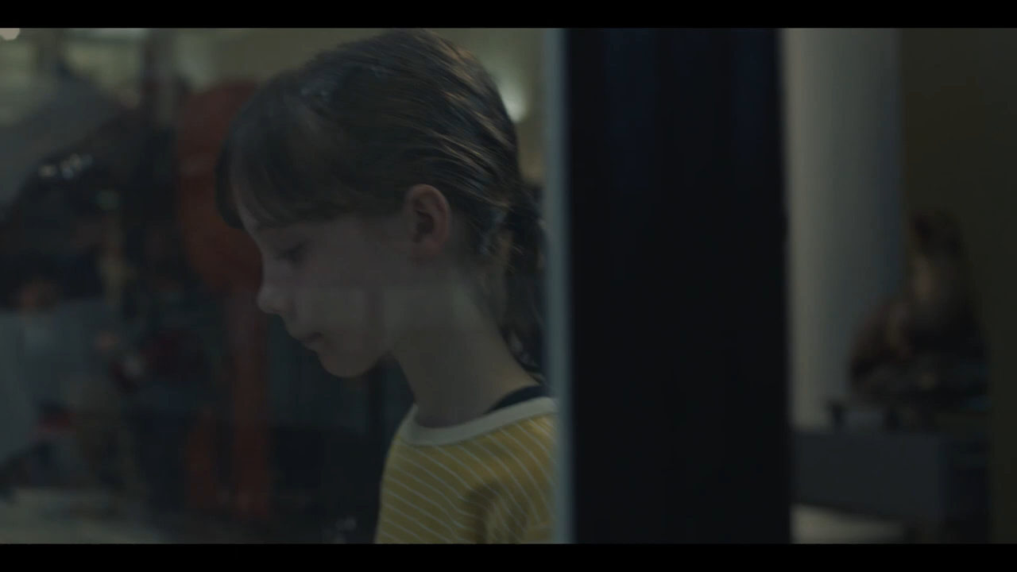

Slide 19

REFLECTION & EXIT TICKET:
Watch the video #HaveAWord and think about how you can intervene if you see abuse happening.
On your way out the door, tell your teacher and a friend how you can stand up for someone being abused (with any kind of abuse).
Mayor of London, Sadiq Khan on Instagram: "Male violence against women and girls starts with words. If you see it happening, have a word with yourself—then your mates. #HaveAWord"
Notes:
Click on the link to view the video.
Mayor of London, Sadiq Khan on Instagram: "Male violence against women and girls starts with words. If you see it happening, have a word with yourself—then your mates. #HaveAWord”

Slide 20
REMINDER:
TOPIC TEST NEXT WEEK
Notes:
Hand out revision
Any time remaining at the end of the lesson can be spent doing revision.

